Slide 1
Computer Vision and Pattern Recognition
~By Bourbakis Nikolaos G.
Team-3
A Registration method of multiple views of the same area - 2023
Members of the project
Kodati Kartheek (w440kxk)
Khadilkar Mousami(w603nxk)
Kolla Poojitha(w362pxk)

Slide 2
Weak Paper
Multi-view SAR image registration based on feature extraction
JiaZheng Sun, Hui Wang, ShiChao Zheng, ZhaoYang Zeng, Xiang Chen, SiLi Wu
Limited generalizability: The proposed methodology is evaluated only on a specific dataset, and it is unclear whether it would perform as well on other datasets with different characteristics.
Lack of real-world testing: While the paper presents experimental results, it is unclear whether the proposed methodology has been tested in real-world scenarios, such as in the context of actual SAR imaging applications. Without such testing, it is difficult to assess the practicality of the proposed methodology.

Slide 3
Parameters we have Improved
Availability: We have Implemented the complete code using the ORB algorithm, with the clear description.
Originality: The Methodology that we used to develop for the weak paper is ORB (Oriented FAST and Rotated BRIEF) Algorithm and we used this algorithm because of its fastness and accuracy.
Robustness: In this methodology we have implemented the code in the way that it will produce the output under various circumstances For example, In different lighting conditions the program executes perfectly.
Reliability: In this methodology the code will execute in expected results under normal conditions. For instance, the given input there will be the expected output.
Speed: We have used ORG Algorithm that has High processing time for the given sample tests.

Slide 4
Bar Graph for Initial and Improved parameters
Maturity value
Parameters

Slide 5
ORB Algorithm
import cv2
# Load the input image
img = cv2.imread('image.jpg')
# Convert the image to grayscale
gray = cv2.cvtColor(img, cv2.COLOR_BGR2GRAY)
# Create a ORB object
orb = ORB_create()
# Detect keypoints and compute descriptors
keypoints, descriptors = orb.detectAndCompute(gray, None)
# Draw keypoints on the input image
img_with_keypoints = cv2.drawKeypoints(img, keypoints, None)
# Display the input image with keypoints
cv2.imshow(‘ORB keypoints', img_with_keypoints)
cv2.waitKey(0)

Slide 6
Flow Chat
START
Load SAR Images
Convert to Grayscale
Detect ORB Features
Extract Feature Descriptors
Match Feature Descriptors
END
Compute Homo-graph Matrix
Warp Sensed Image
Registered SAR Image

Slide 7
Explanation
Load the reference and sensed SAR images.
Convert both images to grayscale.
Detect the ORB(Oriented FAST and Rotated BRIEF) features in both images using the ORB algorithm.
Extract the feature descriptors for the detected features in both images.
Match the feature descriptors from the reference image to those of the sensed image using a matching algorithm, such as the brute-force feature matcher algorithm.
Calculate the homo graph-matrix that maps the matched features from the sensed image to the reference image using a robust estimator, such as the RANSAC algorithm.
Warp the sensed image using the computed homo-graph matrix to align it with the reference image.

Slide 8
Initial Maturity Graph
Maturity Value
Paper No.

Slide 9
Final Maturity Graph
Maturity Value
Paper No.

Slide 10
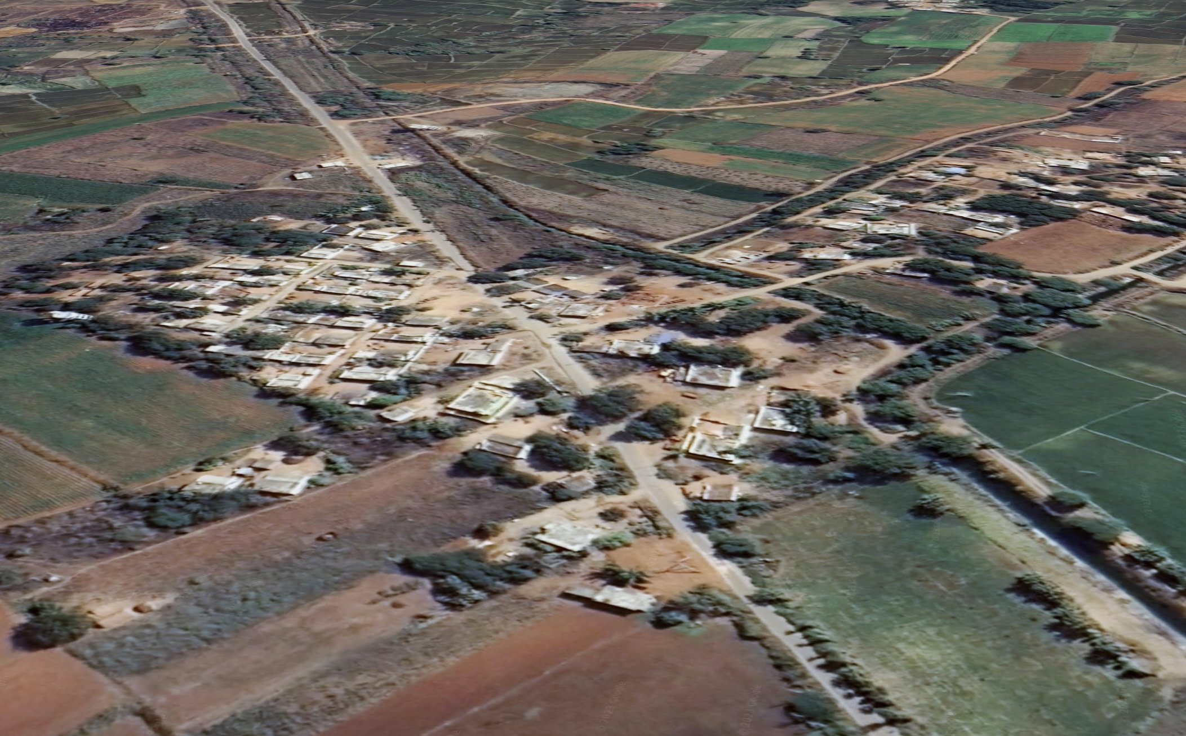
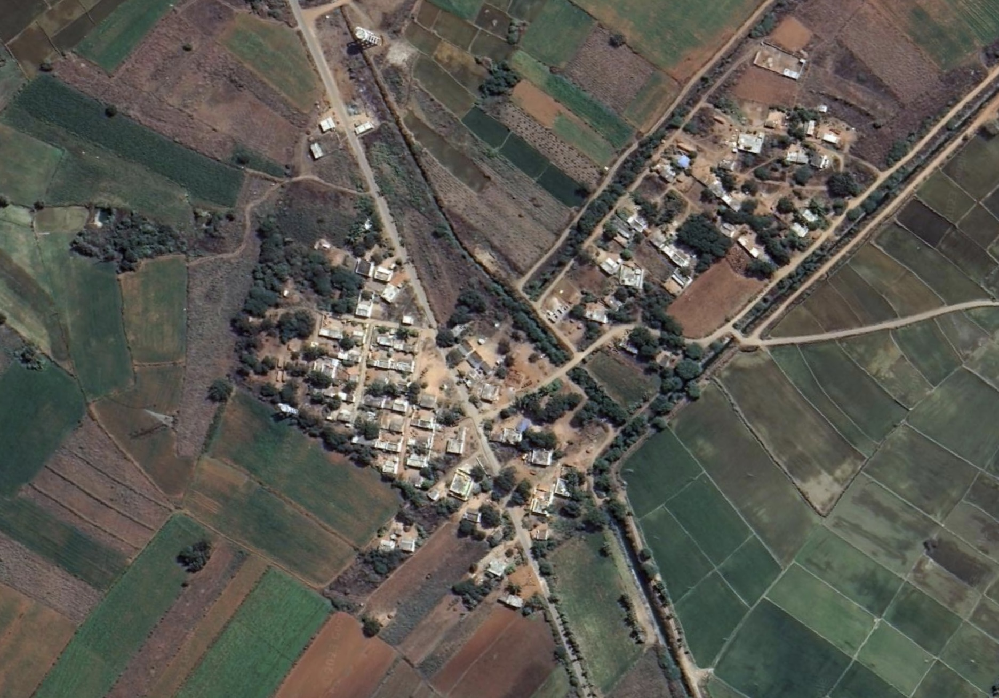
Input Images with different views of the same location
Side view
Top view
Reference Image
Sensed Image

Slide 11
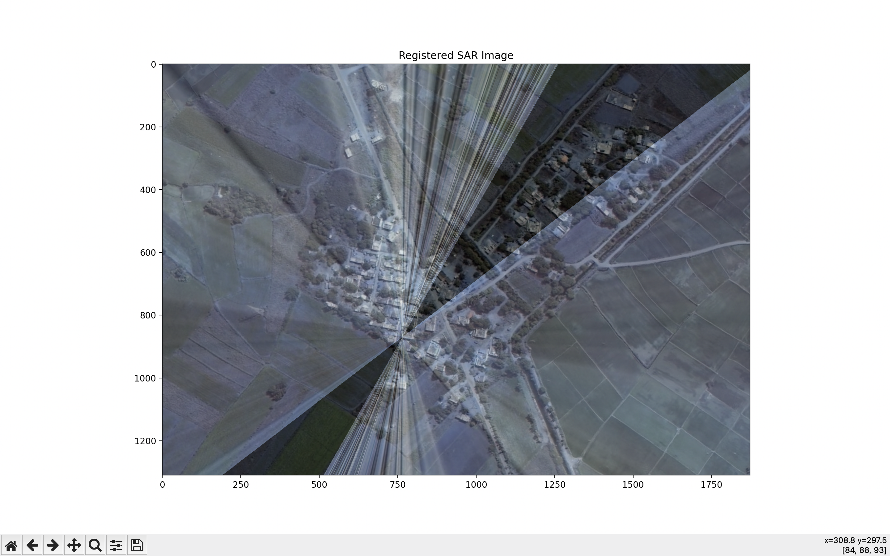
Result of Input Images

Slide 12
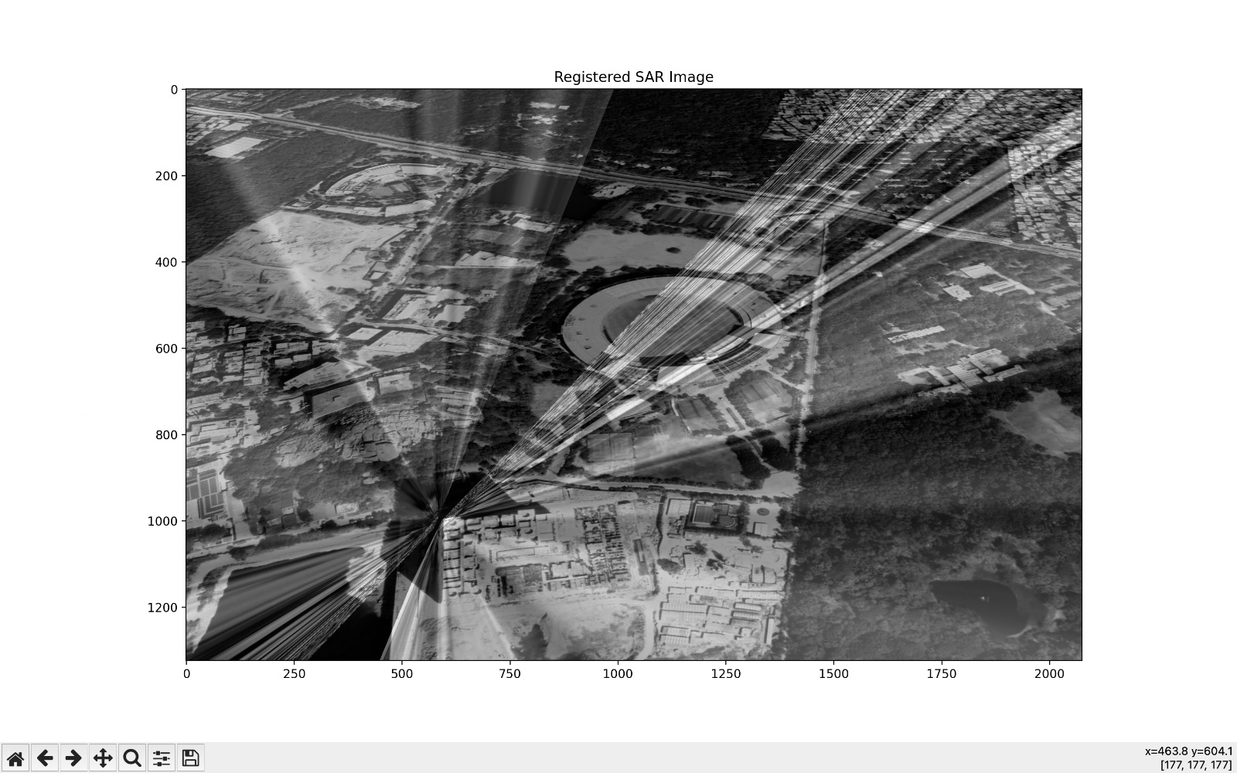
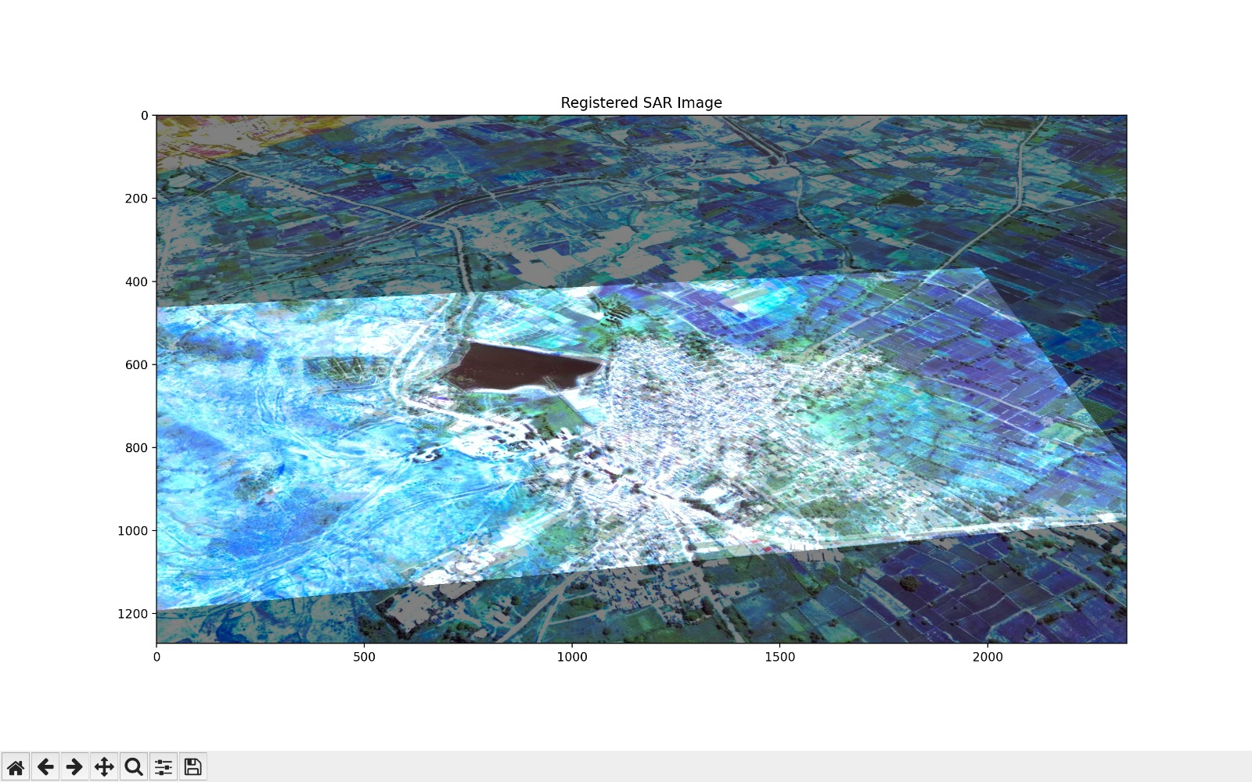
Results under different lighting conditions
Sample-1
Sample-2

Slide 13
Output Explanation
The output of the code is a window displaying the resulting registered SAR image. The registered SAR image is a fused image of the Reference image and Sensed SAR images that have been aligned and have been blended together.
The registered SAR image wraps both reference image and sensed images and produces the output with the shaded lines in the common region.
The image window will remain open until a key is pressed, at which point the program will terminate and the window will close.

Slide 14
Thank You
~Any questions

